Slide 1


By Abdelrazek Rizk

Slide 2
1.Background:
Pharmacies chain stores in the United States
The number of community pharmacies increased by 6.3%, from
63,752 pharmacies in 2007 to 67,753 pharmacies in 2015
The top 25 pharmacy chain stores represent about 28,000 pharmacy locations in the U.S. and employ about 46,000 on- staff pharmacists

Slide 3
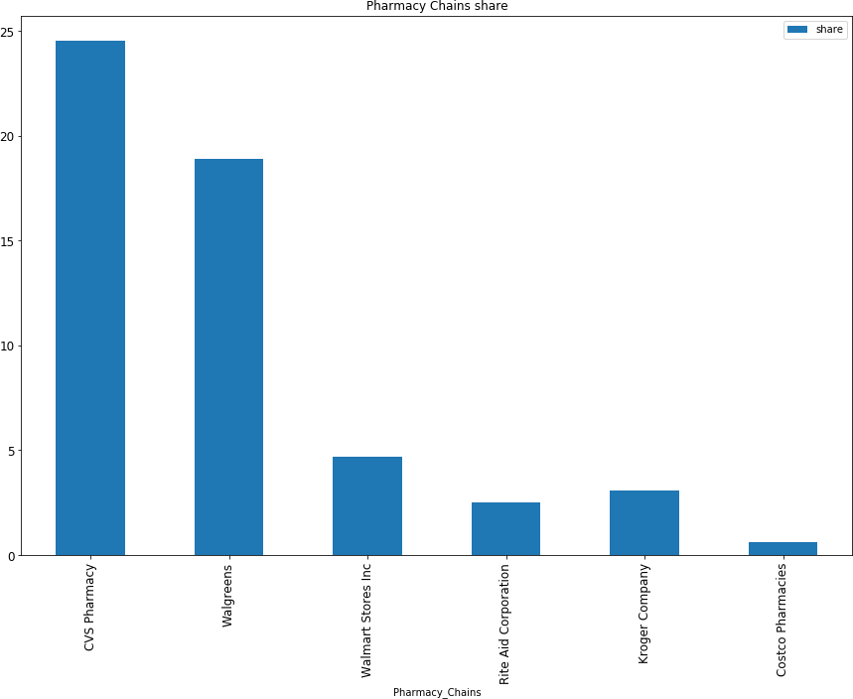
2. Pharmacy Chains share :

Slide 4
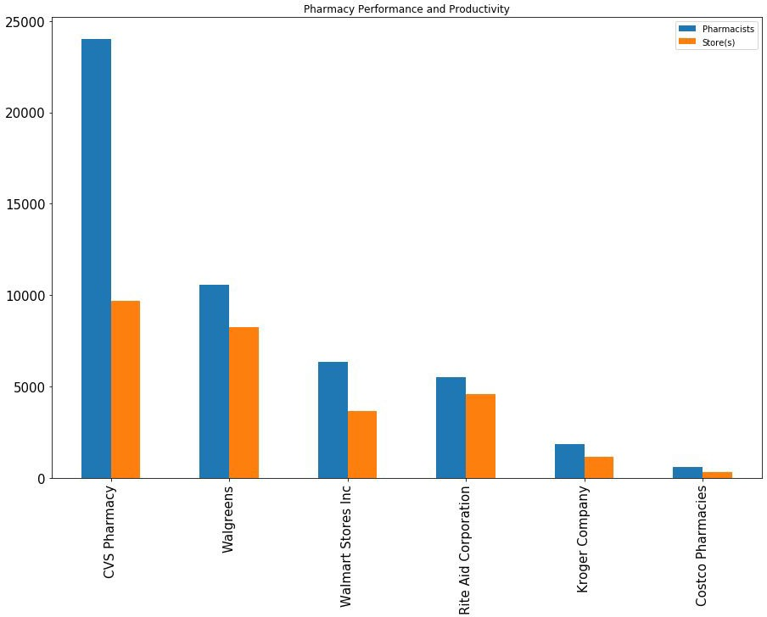
3. Pharmacy Performance and Productivity :

Slide 5
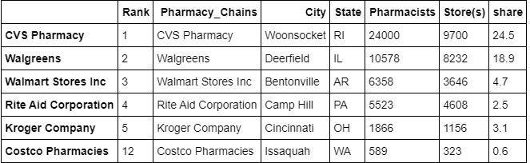
4.Pharmacy Chains Info

Slide 6
5. Pharmacy Chain Distributions :

Slide 7
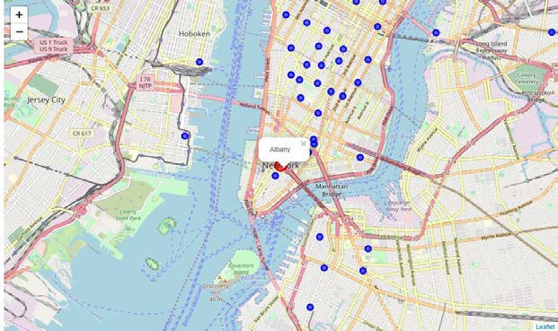
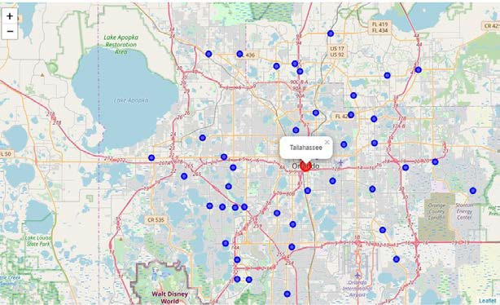
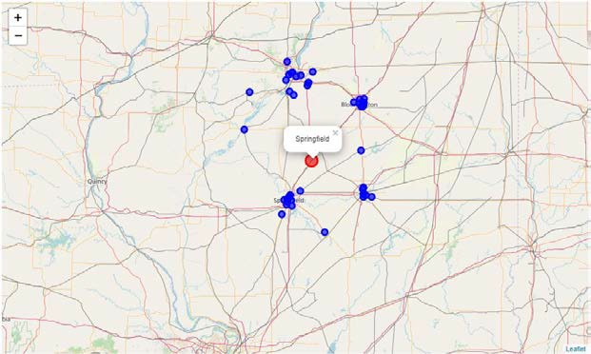
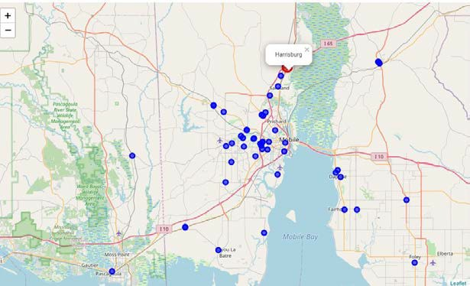
New York, NY | Florida, FL
Pharmacy distributed normally North the state Capital City | Pharmacy distributed normally around the state Capital City
Illinois ,IL | Pennsylvania, PA
Pharmacy distributed The outskirts the state of Capital City | Pharmacy distributed normally South the state Capital City

Slide 8
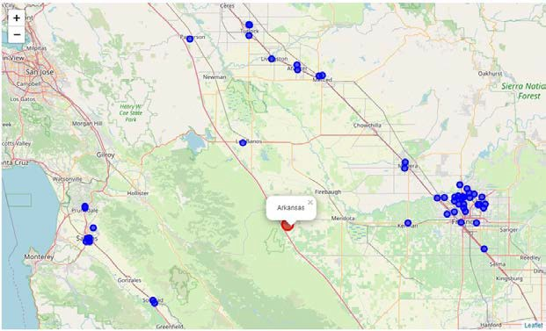
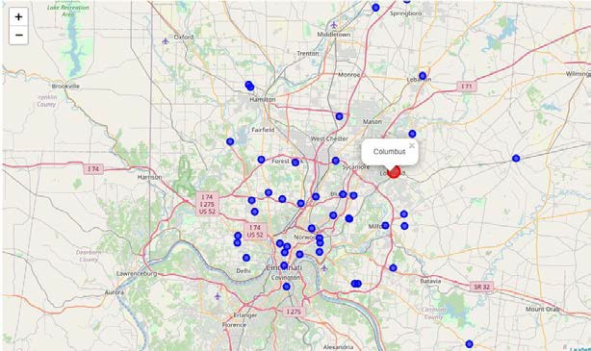
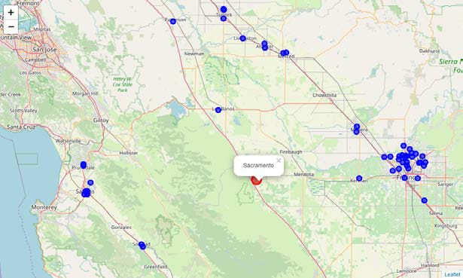
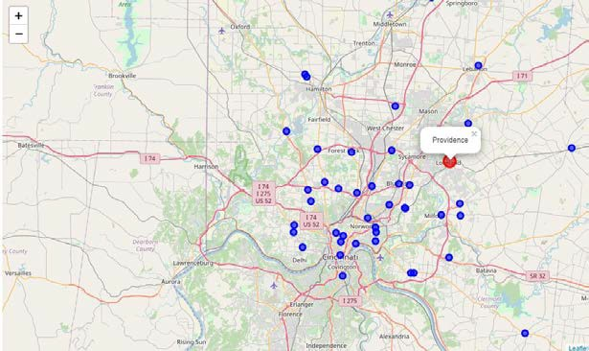
Arkansas, AR | Ohio, OH
Pharmacy distributed The outskirts the state of Capital City Notice: Arkansas, Sacramento and Austin almost the same | Pharmacy distributed normally around the state Capital City
California, CA | Rhode Island
Pharmacy distributed The outskirts the state of Capital City Notice: Arkansas, Sacramento and Austin almost the same | Pharmacy distributed normally around the state Capital City

Slide 9
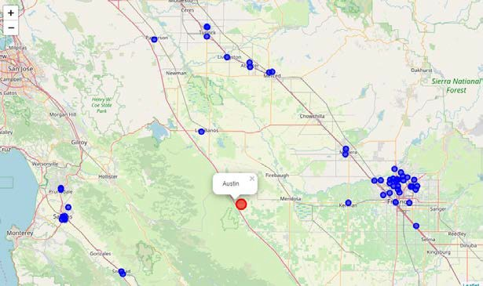

Texas, TX
Pharmacy distributed The outskirts the state of Capital City Notice: Arkansas, Sacramento and Austin almost the same

Slide 10
5. Conclusions:
In that case for given recommendation to our client about The best choice to make an offer to a pharmacy chain We use data visualization, data mining, and Geo Capital maps
To give the best solution We found that
CVS Pharmacy chain had employee 24,000 Pharmacists to run
9,700 Store(s) about ~2.4 Pharmacists/store
And has 24.5% market drug sales share about 68.6 billion U.S. dollars in 2018

Slide 11
In the other side Walgreens Pharmacy chain had employee 10,578 Pharmacists to run 8,232 Store(s) about ~1.2 Pharmacists/store
And has 18.9% market drug sales share about $54 billion U.S. dollars in 2018
And we search about additional information about market value
https://www.gobankingrates.com/money/business/how-much-is-walgreens-worth/ https://www.gobankingrates.com/money/business/how-much-is-cvs-worth/
CVS Pharmacy chain Net Worth $152.2 billion U.S. dollars
Walgreens’ Pharmacy chain Net Worth $105.6 billion U.S. dollars in 2018

Slide 12
6. Feedback and Recommendations:
We will give our client to make his offer to Walgreens Pharmacy
chain as it is less than CVS Pharmacy in Net Worth
By ~$50 billion U.S. dollars
And our client yes he will run 1,468 stores less than CVS Pharmacy but he will saving wages for 13,422 Pharmacists
11-Apr-20

